Slide 1
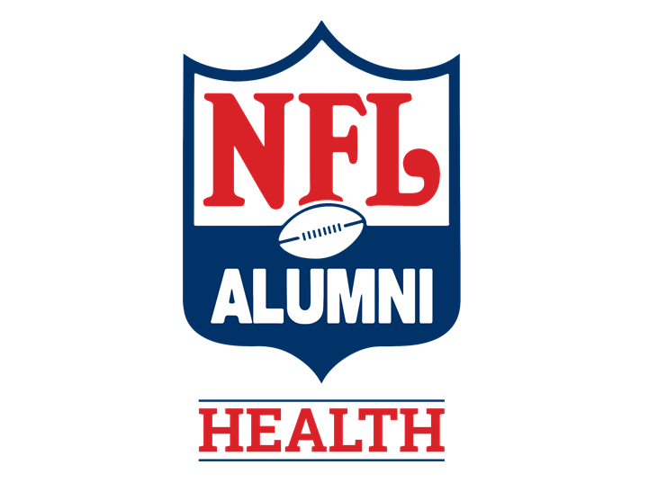
Retired NFL Players
“AN UNDERSERVED AND UNDER-REPRESENTED CLINICAL TRIALS COHORT”

Slide 2
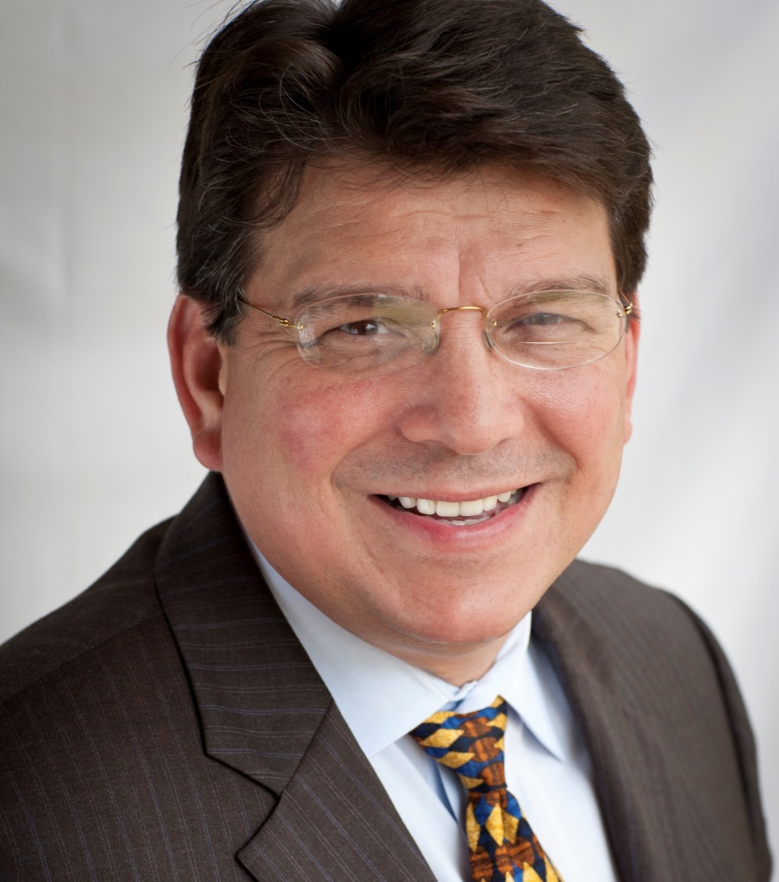
Jaime R. Garza, MD, DDS, FACS
Professor (Clinical) of Orthopedics- Tulane University School of Medicine, Director of Human Regenerative Cell Trials
Professor (Clinical) of Surgery- University of Texas Health Center at San Antonio
Former Player-NFL Alumni member
Senior Medical Advisor to the NFL Alumni

Slide 3
The NFL Alumni Association -oldest and most recognizable national organization of retired athletes.
~10,000 Former players, coaches, executives, spouses, cheerleaders and associate members.
Dual mission-
“Caring for Kids”
“Caring for Our Own”
Notes:
“Caring for Kids” by giving back to local youth charities through 40 chapters throughout the U.S.
“Caring for Our Own” by serving members, families and community.

Slide 4
NFL Alumni Health is a wholly-owned subsidiary of NFL Alumni
Offering informational resources, programs, services for NFL Alumni members and the general public.

Slide 5
~10,000 NFLA members
2022 ethnic makeup
~56% African descent
~25% Caucasian descent
~0.4% Hispanic descent
~Remainder are Pacific islanders, Asian, others

Slide 6
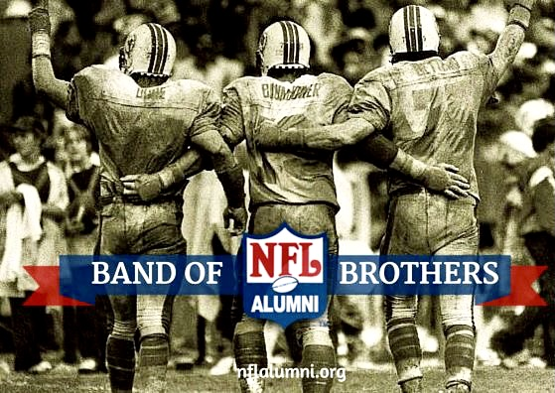

Slide 7
Relatively few well controlled studies published on the health of ex-NFL players
Snapshot of Cohort

Slide 8
Published Research Papers (58)
Brain health(28)
Health & Wellness(10)
Law & Ethics(7)
Heart health(5)
Pain(5)
Mobility(4)
Sleep(2)

Slide 9
Examined the occurrence of four chronic diseases in 2,864 former players under the age of 60,
arthritis, dementia/Alzheimer’s Disease, hypertension, and diabetes.
results from former players compared to general public
Players were matched with people of the same age, race and body mass index
Grashow R,et al. Healthspan and chronic disease burden among young adult and middle-aged male former American-style professional football players. British Journal of Sports Medicine 2023;57:166-171

Slide 10
Findings:
Players generally “looked older than their chronological age when they came in for testing” (almost 10 years ahead of the general population)
>20% of NFL retirees diagnosed with arthritis in their mid-to-late 20s, compared to 5% of non players
47% of former players in their 40s, have arthritis, compared to 19% of non-players.

Slide 11
Findings:
The former players more likely to have diabetes and high blood pressure in the second half of their 20s.
>12% of former players have high blood pressure and ~7% have diabetes before age 30
Compared to 6.5% and 1% of other men their age.
On average, ex-players had 10 fewer years of “health span”
Notes:
On average, ex-players had 10 fewer years of “health span”
were without hypertension, arthritis, Alzheimer’s/dementia, and/or diabetes

Slide 12
*Early-Onset Arthritis in Retired National Football League Players. Journal of Physical Activity and Health, Volume 6: Issue 5, pp.638–643
Arthritis is over 3 times more prevalent in retired NFL players than in the general U.S. population in males under the age of 60.*
This excess of early-onset arthritis may be due to the high incidence of injury in football.
Notes:
In another study by a different institution it was found that Arthritis is over 3 times more prevalent in retired NFL players than in the general U.S. population in males under the age of 60.*

Slide 13
Kyle Richardson and Billy Davis
Proactive health surveys
Webinars on health topics
“Huddle Up” for Obesity
Huddle Study- Heart disease
Medical Advisory Board- Lee Rice, DO, Robin L. Smith, MD, MBA, Jim Kovach, MD, JD (former player), Jaime R. Garza, MD, DDS (former player)
Corporate sponsorships

Slide 14
“Huddle For Health” Initiative
Community ambassador arm
Partnering for community health
Utilizing “hub and spoke” model of 40 local chapters and former NFL players well known in the local communities across USA.
i.e., CDC COVID-19 Vaccination awareness campaign

Slide 15
500 participants representing almost every NFL team during 8 events
Participants underwent 2 non-invasive “heart screening” procedures
Shared Information on heart function, heart diseases, and how to live a heart healthy life.
HUDDLE Study was concluded in August of 2022.
A study to assess the risk factors of heart disease in NFL Alumni
Sponsors: NFL Alumni Health and Edwards Lifesciences
Principal Investigator: Lee Rice, D.O.
Partnered with Association of Black Cardiologists

Slide 16
Data currently being reviewed for publication
Takeaways:
100% participation to completion of study
~15% of participants were urgently referred for serious conditions that they were unaware of.
Minorities are at a higher risk for heart disease
Everyone needs to be more proactive about their heart and risk factors
A study to assess the risk factors of heart disease in NFL Alumni
Sponsors: NFL Alumni Health and Edwards Lifesciences
Principal Investigator: Lee Rice, D.O.
Partnered with Association of Black Cardiologists

Slide 18
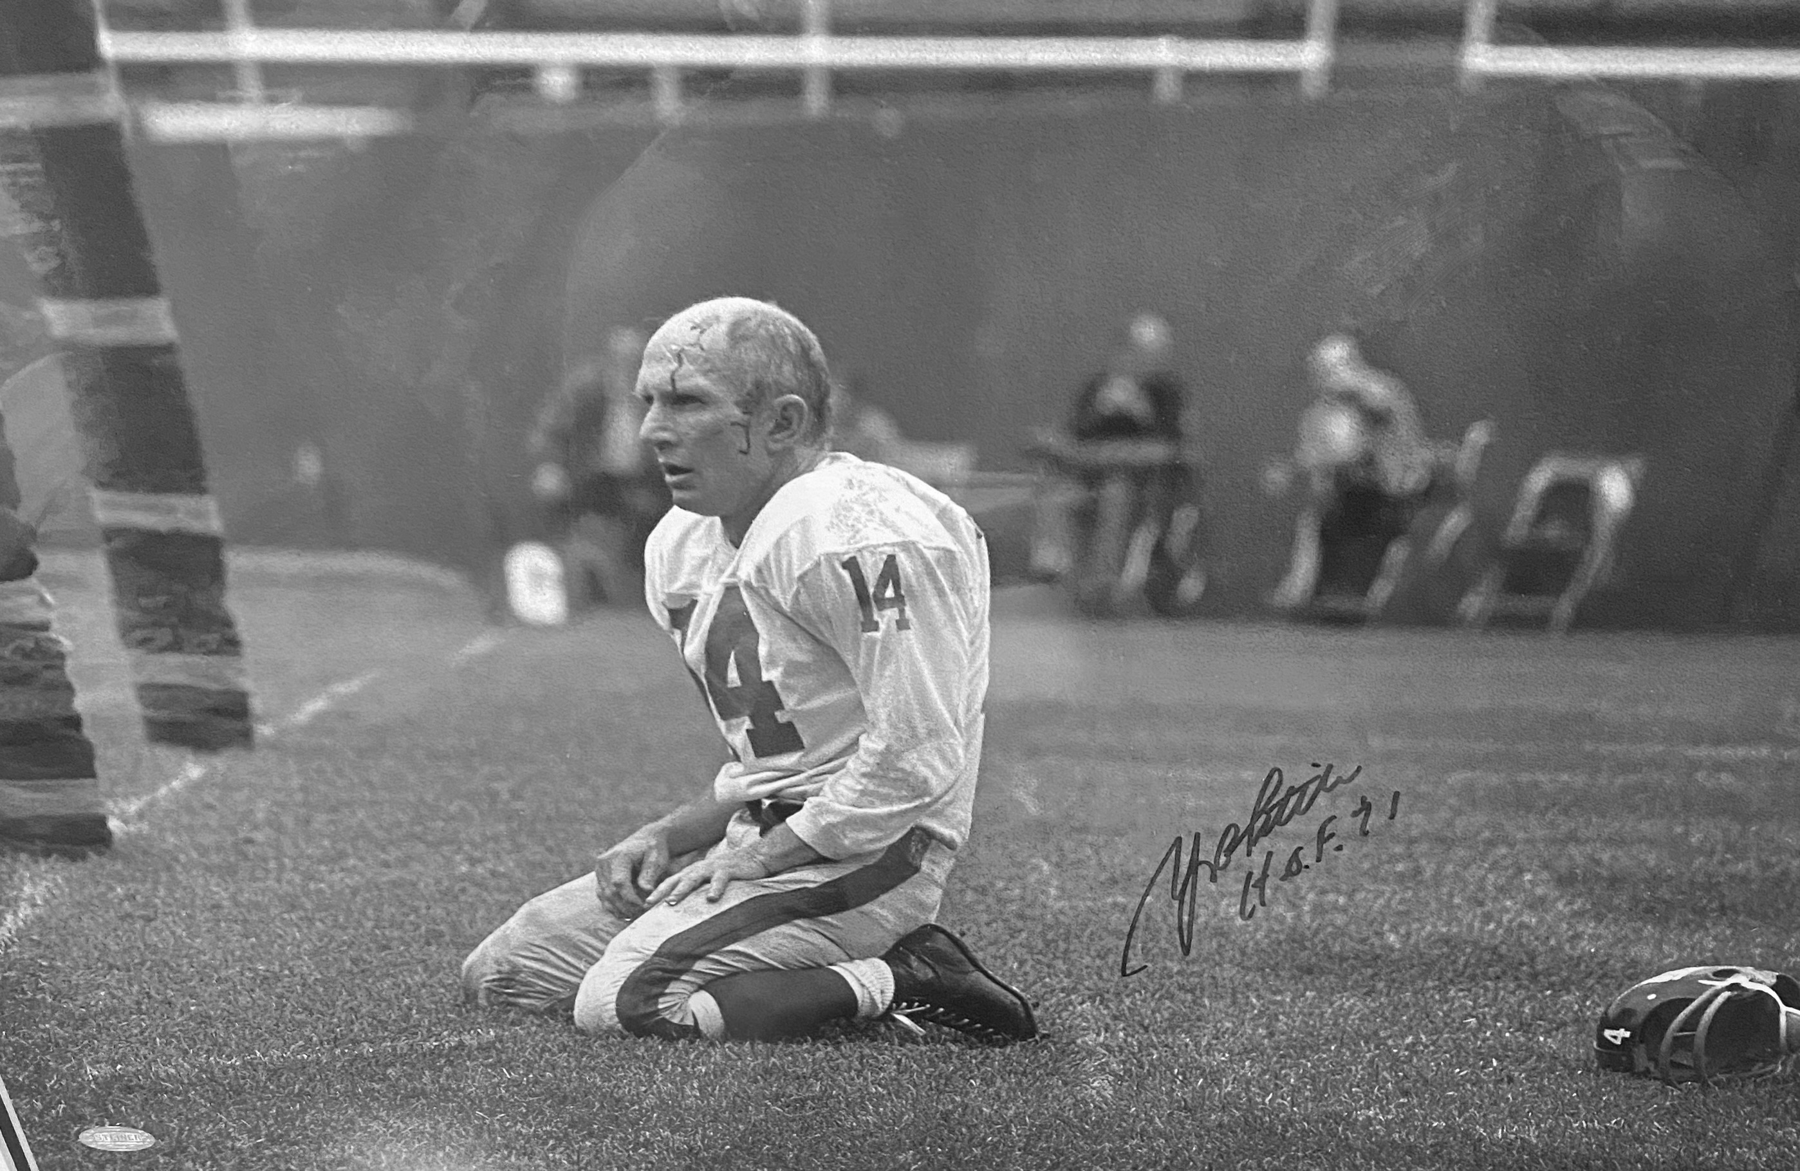
Aging population with early onset disease
Played when salaries were low
Struggle to find adequate health insurance
Struggle to find good health care providers who understand
Are unaware of results of studies that affect them as ex-NFL players
Very low participation in clinical trials that could help solve some of the health issues
Very little participation in FDA cell therapy trials

Slide 19
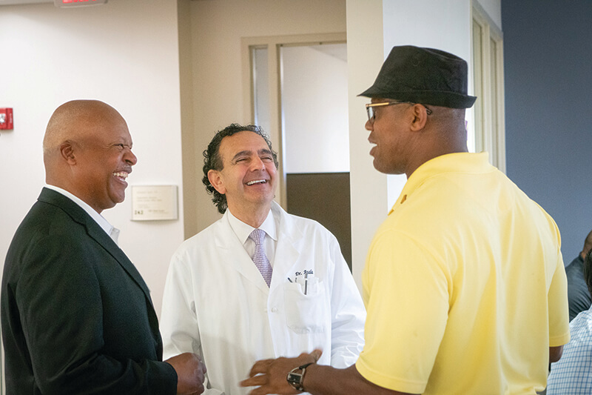
Wake Forest IRM NFL-DAy
Dr. Tony Atala and Johanna Elin Marie Bolander, PhD
30 former players visited and shared issues and concerns
WFIRM researchers are developing a treatment that targets the inflammation in the joint while also addressing the damaged cartilage and subchondral bone.
“there are no long-term solutions available for most of these former pros, some of whom are as young as their early 30s”.
Dr. Bolander emphasized that “research advances will depend on additional funding. With more funding, the sooner the treatments can reach the clinic”

Slide 20
How can one help?
Reach out to NFL Alumni Health
@ NFLALUMNIHEALTH.ORG
Sponsor trials
Sponsor members for clinical trials
Recommend well designed and FDA approved trials
Partner with the NFLA for community outreach programs in local communities
Corporate sponsorships

Slide 21
Thank you from the NFL Alumni Association and its members!
NFLALUMNIHEALTH.ORG

